Slide 1
Maciej Misztal (@mmisztal1980)
Setting up a CI/CD Pipeline for a containerized project in VSTS

Slide 2
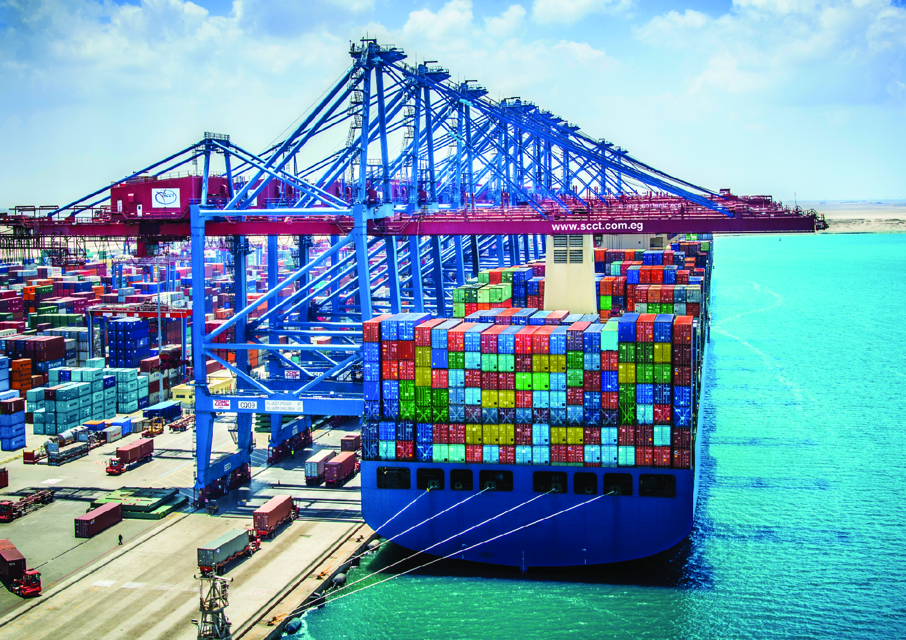


Setting up a CI/CD Pipeline for a containerized project in VSTS
@mmisztal1980
50mins

Slide 3


About me (work)
@mmisztal1980

Slide 4






About me (tech)
@mmisztal1980
Notes:
Technologies I’m passionate about or work with
I definitely conside myself to be a nerd

Slide 5
About me (communities/meetups)
.NET Developers Poland
Azure Usergroup Poland
WG.NET
KMUG Warsaw
@mmisztal1980
Notes:
I like to listen to people who are wiser then me
I like to share what I know

Slide 6

About this presentation
@mmisztal1980
Notes:
Presentation and code available on GitHub
This is the 1st iteration of this presentation
I intend to extend it in the future with further demos

Slide 7
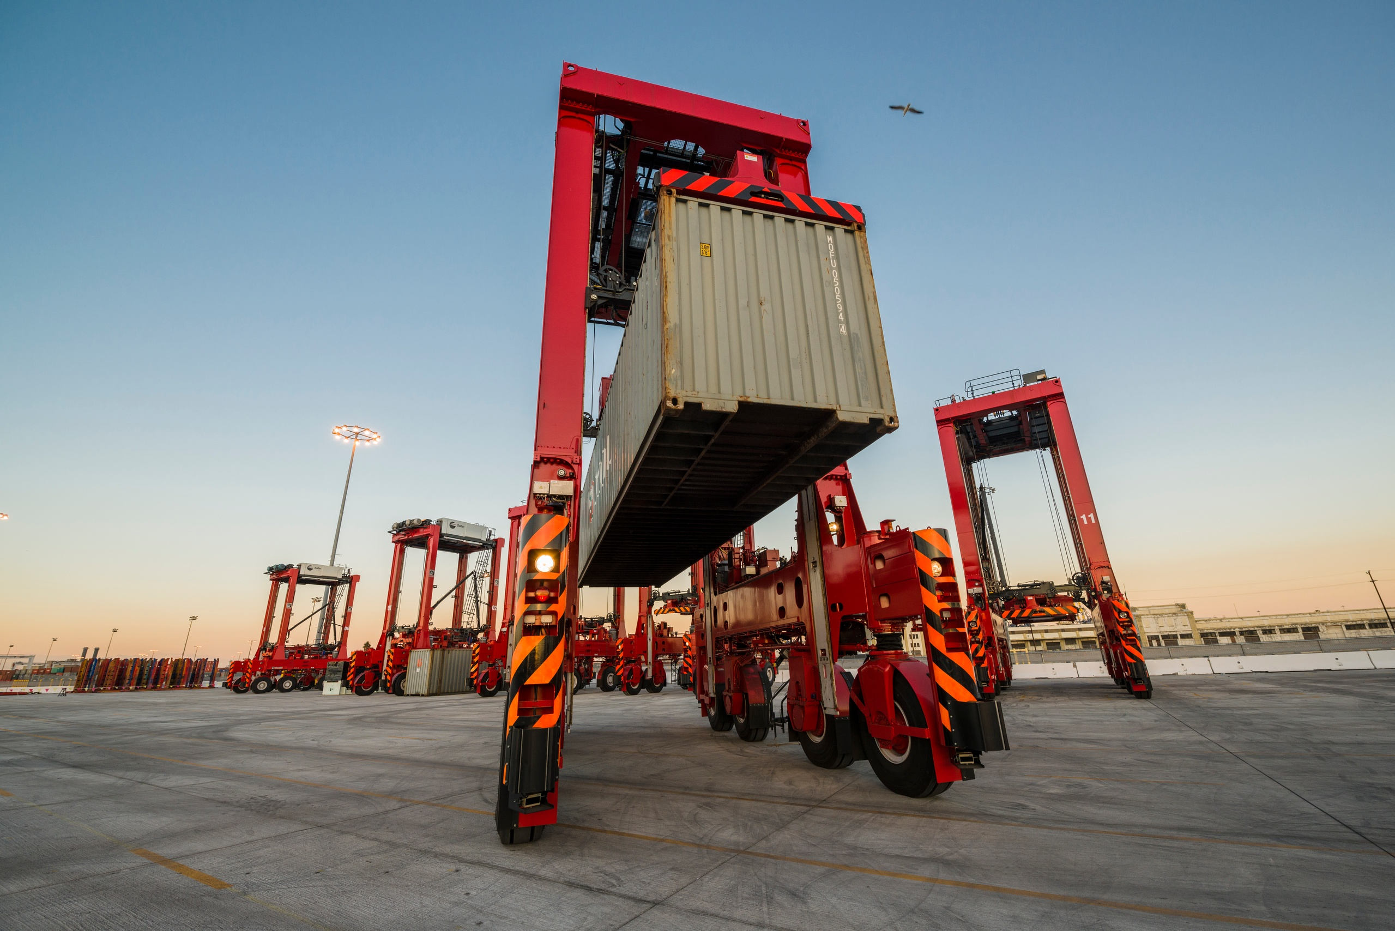
What are we going to talk about ?
Notes:
This is a sponsor session
I probably won’t make this talk memorable so I’ll at least try to make it useful
We are not going to take a crash-course in docker, nor are we going to talk about what docker is – we’re assuming everyone is familiar with the basics
We’re going to setup a deployment process for a container based solution
We’re going to Focus primarily on Linux containers
We’re going to automate the container builds
We’re going to push the containers to a private container registry
We’re going to deploy the containers to different kinds of environments and briefly discuss those environments
We’re going to identify and eliminate pitfalls along the way

Slide 8
Containers vs Virtual Machines
Applications
Bins/Libs
Guest OS
Containers
Hypervisor
Docker Engine
OS
OS
Bare Metal
Bare Metal

Slide 9
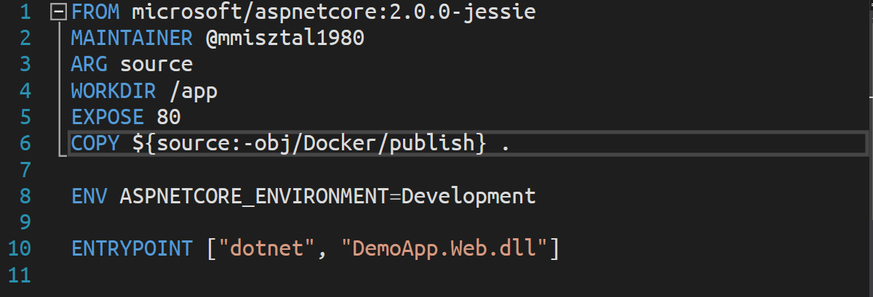
The Dockerfile
Notes:
Each line is a layer
Rebuilds are instant
If n-th layer changes, only this and the following layers are rebuilt
It’s possible to reduce the numer of layers by chaining some of the bash script in RUN statements

Slide 10
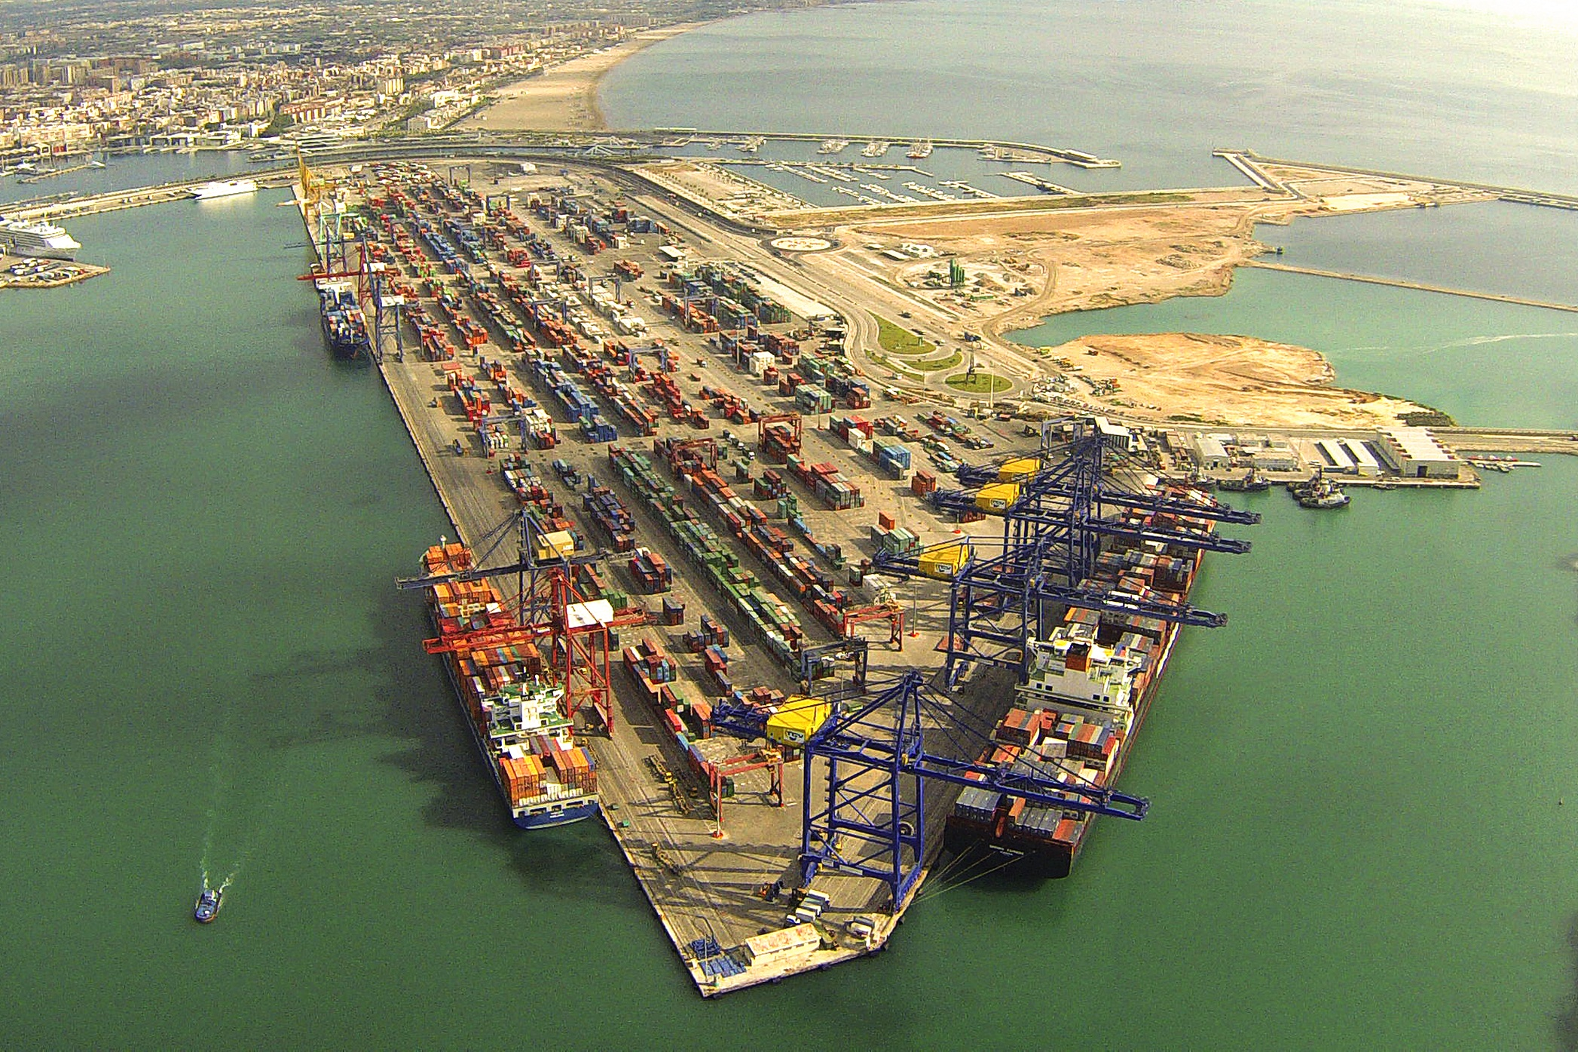
The Demo Project Architecture

Slide 11

The Demo Project Architecture
Public Goverment REST Service
DemoApp.Web (Asp.NET Core 2.0 MVC)
PostgreSQL Database
Notes:
Simple MVC project
Can execute REST calls to a goverement API exposing information about air quality sensors
Can persist that information to a PostgreSQL database
Why PostgreSQL
Rock-solid alternative to MSSQL Server
MSSQL Server container requires 4GB of RAM
There’s an EF Core provider for PostgreSQL
Capable of storing relational data
Capable of storing GIS data
Capable of storing NO-SQL documents data (Marten)

Slide 12

Building a docker-enabled project with the .NET CLI

Slide 13
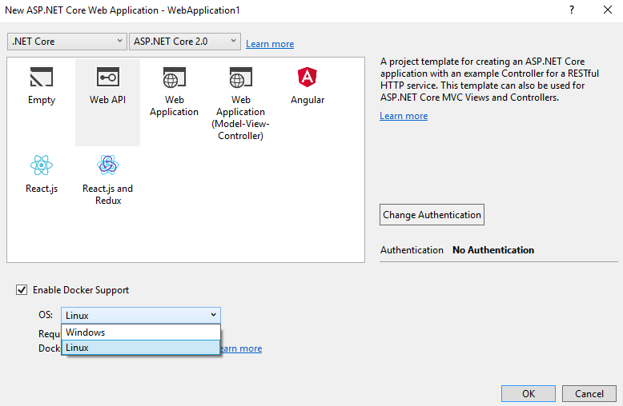
Docker Support in Visual Studio 2017
Notes:
Docker for Windows must be running
You need to be using Hyper-V
docker-compose.dcproj is created
docker-compose.yml is created
docker-compose.ci.build.yml is created

Slide 14
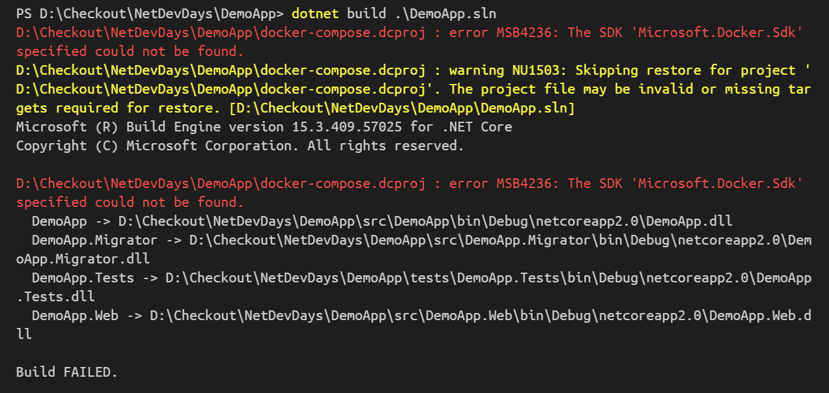
Building your project with dotnet-cli
dotnet build ./DemoApp.sln
Notes:
- This is what happens if the docker integration is enabled and you attempt a dotnet build

Slide 15



Building your project with dotnet-cli (workaround)
GitHub: dotnet/cli Issue #6178
C:\Program Files (x86)\Microsoft Visual Studio\2017\Professional\MSBuild\Sdks
Microsoft.Docker.Sdk
C:\Program Files\dotnet\sdk\2.0.{X}\Sdks
/usr/share/dotnet/sdk/2.0.{X}/Sdks
Exclude build & tools folders

Slide 16
Building your ASP.NET Core container targeting Linux
Change the base image to :
microsoft/aspnetcore:2.0.0-jessie
Remember to include the RID in ‚dotnet publish’ (debian.8-x64)
Notes:
In my case, the RID is included in the docker-compose.ci.yml

Slide 17
Building your project with docker-compose
docker-compose –f docker-compose-ci.build.yml up
Change the image to :
microsoft/aspnetcore-build:1.0-2.0
Notes:
The container image contains all of the required dependencies to build the project, like SDKs, targeting packs etc.
The container tag must be 1.0-2.0 to avoid the missing Docker.SDK problem
/bin/bash –c enables chaining commands

Slide 18
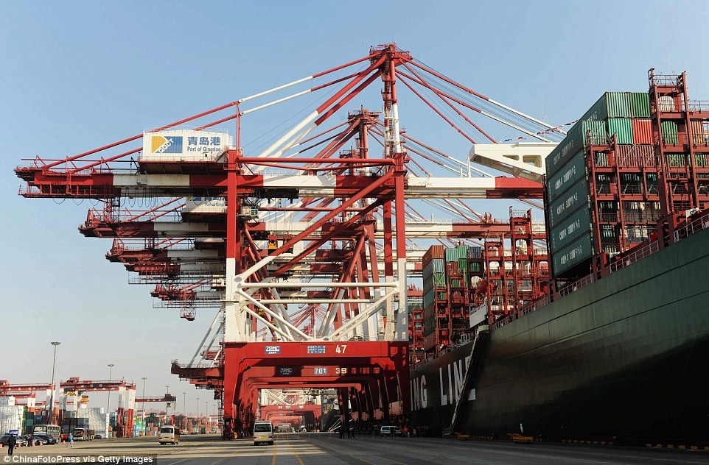
Visual Studio 2017
The Docker Tooling
Notes:
VS 2017 15.4

Slide 19
The VS 2017 Build Process
Debug → obj/docker/empty
Release → obj/docker/publish
Notes:
The Dockerfile contains a build arg called „source”. It can be passed using –build-arg source=value
COPY will take source OR obj/docker/publish
COPY will copy everything to the WORKDIR
In Debug the source dir is empty and only a single delta-layer is generated, containing a YAML file

Slide 20
What VS 2017 does…
docker-compose -f "{project-root}\docker-compose.yml" -f "{project-root}\docker-compose.override.yml" -f "{project-root}\obj\Docker\docker-compose.vs.debug.g.yml" (…)
or…
docker-compose -f "{project-root}\docker-compose.yml" -f "{project-root}\docker-compose.override.yml" -f "{project-root}\obj\Docker\docker-compose.vs.release.g.yml" (…)
Notes:
During the build docker-compose chains multiple files, based on the current build configuration

Slide 21
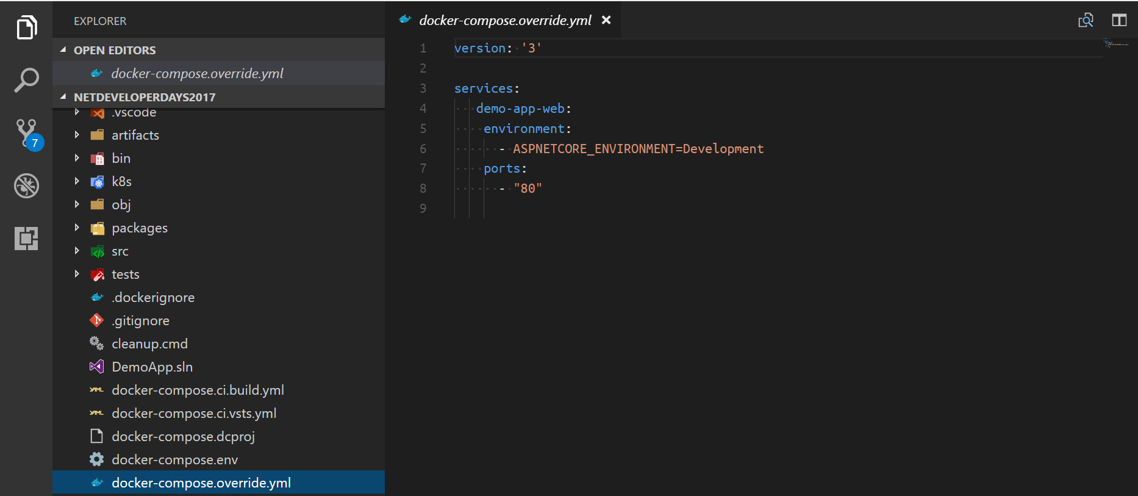
And what happens inside ?...
Notes:
docker-compose.override.yml is relatively simple
It sets the ASPNETCORE_ENVIRONMENT variable
It also sets the container’s port

Slide 22
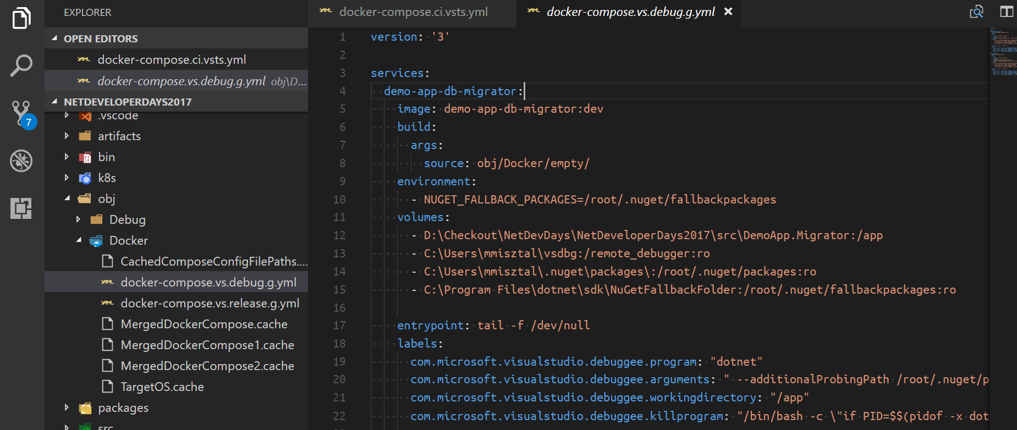
… during a DEBUG build?
Notes:
./obj/Docker/docker-compose.vs.debug.g.yml:
Contains the app volume mount
Contains the debugger volume mount
Contains the nuget volume mount(s)
Source is from obj/Docker/empty

Slide 23
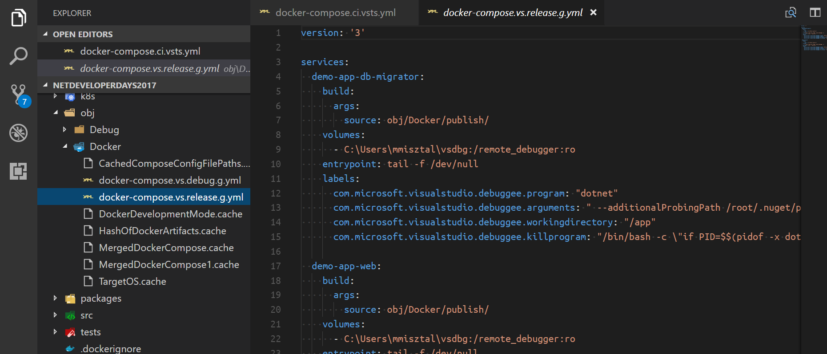
… during a RELEASE build?
Notes:
./obj/Docker/docker-compose.vs.debug.g.yml:
Contains the app volume mount
Contains the debugger volume mount
Contains the nuget volume mount(s)
Source is from obj/Docker/publish

Slide 24

Do we really need all this?
DEMO
Notes:
In this demo:
We will sacrifice the VS integration in order to achieve a more CI-friendly solution
We will build and start our project purely with docker-compose
We will clearly identify the build artifacts
(Note) I wasn’t able to build with docker-compose on an VSTS agent yet. 1 unresolved problem.

Slide 25
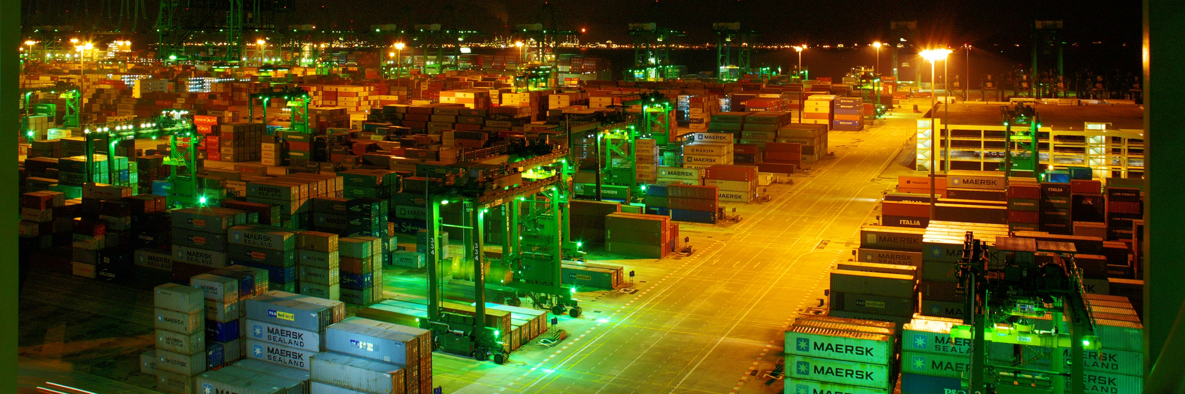
VSTS
Visual Studio Team Services

Slide 26


VSTS Features
Notes:
Free for up to 5 users
Access to Hosted Agent Queues (Win/Linux)
You can have any numer of agents you want
Pipelines control how many paralel agents can be active

Slide 27
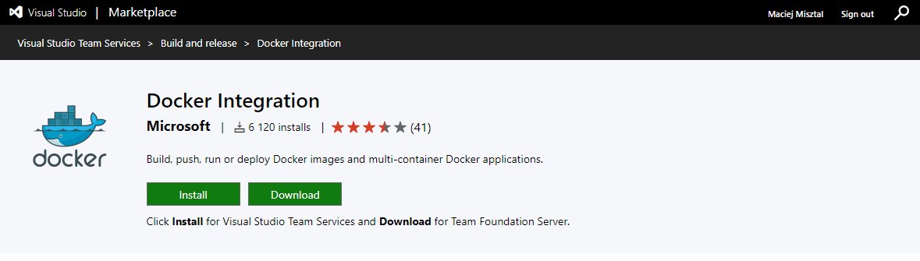
VSTS Docker Extension
Notes:
Available from the VSTS Marketplace which is the key extensibility mechanism for VSTS
Free
Official MS Extension
Contains Docker Task
Contains Docker-Compose Task

Slide 28
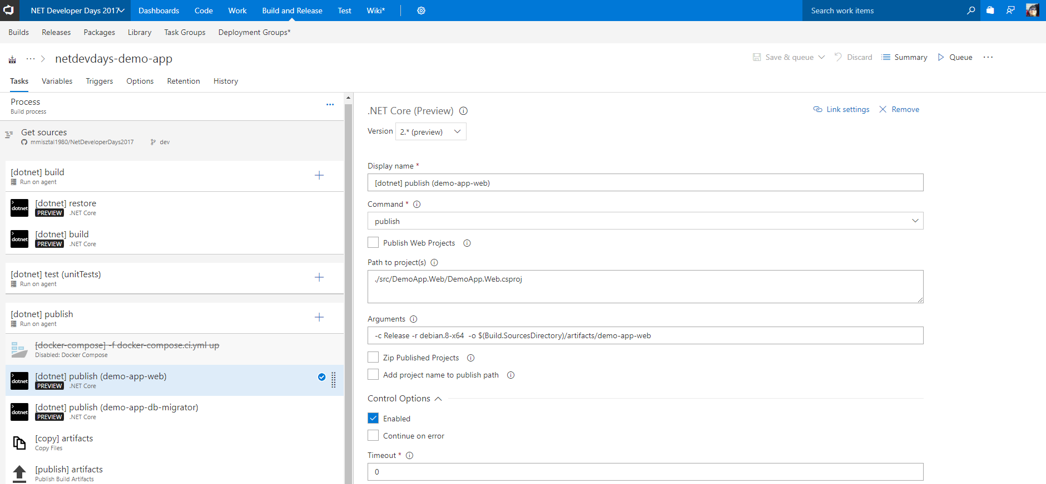
VSTS Builds
Task Configuration Panel
Build Phases & Tasks
Task Control Options
Notes:
Builds are sequential
They can be subdivided into phases
Phases can run on different agents
Builds can emit artifacts which are release triggers

Slide 29
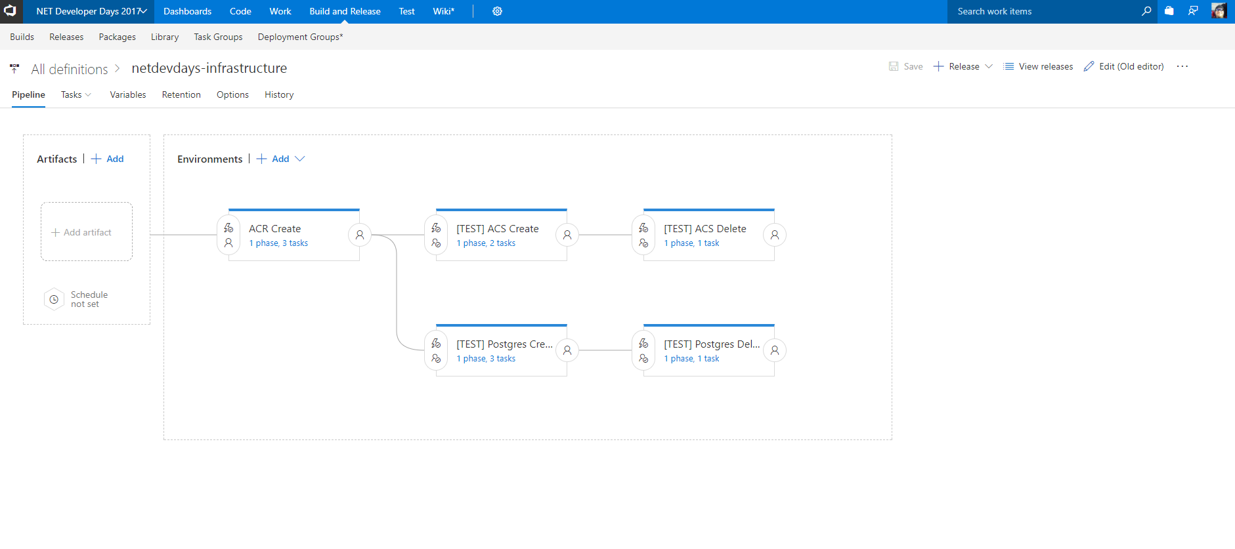
VSTS Release Pipeline
Artifacts
Environments
Notes:
Pipeline editor is a recent feature allowing more complex deployment scenarios
Artifacts :
Can link multiple artifacts
Can use an artifact as a CD trigger
Can do per-branch filtering to trigger
Enviromnents:
Contains a collection of sequential phases
Phases can be agent or server based
Contains trigger conditions
Contains predeployment approval settings
Contains postdeployment approval settings

Slide 30
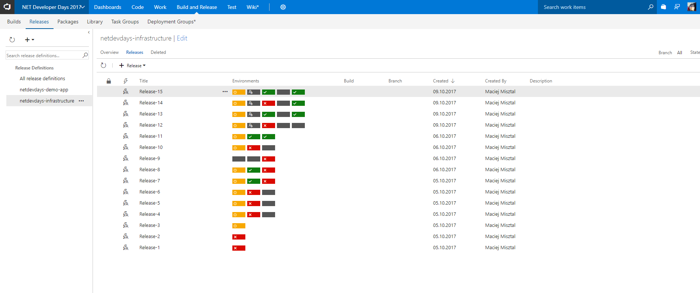
VSTS Releases View
Notes:
1x Box = 1x Environment
Gray = unstarted
Gray with user icon = waiting for pre-deployment approval
Red = failed
Yellow = partially succeeded (something failed but we can deal with it)
Green = successful

Slide 31
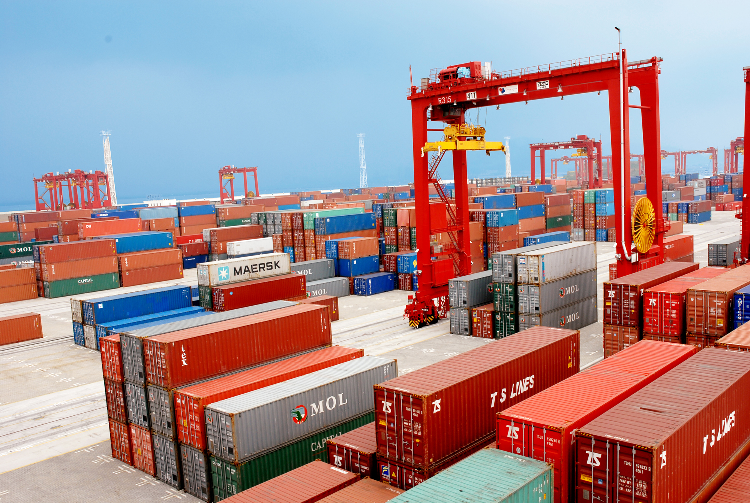
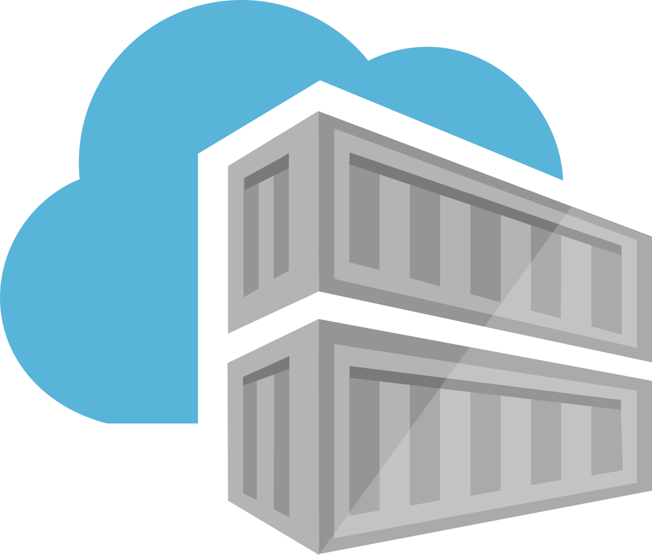
The Azure Container Registry
ACR

Slide 32
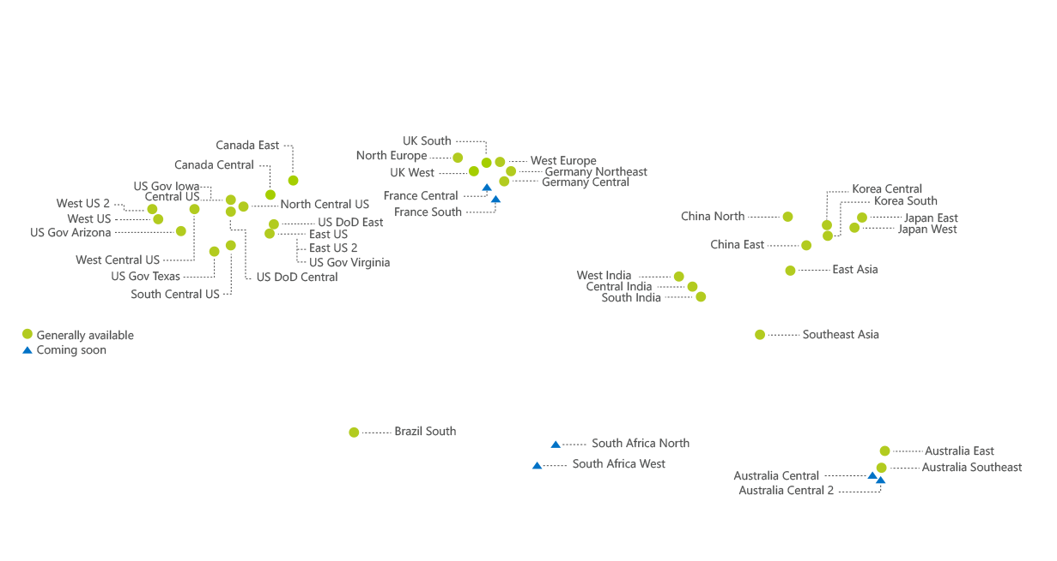
ACR Availability
GA since March 2017
Notes:
Available in mostly everywhere, with some minor exceptions like
West India
China North
China East

Slide 33
ACR Provisioning (azure-cli)
az group create --name {resource-group-name} --location {resource-group-location}
az storage account create --resource-group {resource-group-name} --name {storage-account-name} --sku Standard_LRS
az acr create --name {acr-name} --resource-group {resource-group-name} --sku Basic --admin-enabled true --storage-account-name {storage-account-name}
Keep your ACR in the same region,
as your deployments
Result: {acr-name}.azurecr.io
Notes:
Q to Audience : Why is it important to keep ACR close to the deployment area?
Containers will be available quicker
NW Traffice costs will be eliminated as everything will transpire within a single Azure region

Slide 34
Let’s see the ACR
DEMO
Notes:
In this demo:
We will see the provisioned Azure Container Registry
We will see the containers that have been pushed into the registry
We will see the administrative credentials that can be used to authenticate with the private registry

Slide 35

Azure
Container-Cabable Services

Slide 36


What are the container-enabled services in Azure?
Azure AppService(s)
Azure Service Fabric
Azure Container Service
Azure Container Instances
Notes:
AppService (win/nix)
ASF (win/nix)
ACS (nix/win on k8s preview)
ACI

Slide 37
So.. What are we going to do next?
AppService
ACS
Code
VSTS
ASF
ACR
ACI
Notes:
AppService (win/nix)
ASF (win/nix)
ACS (nix/win on k8s preview)
ACI

Slide 38
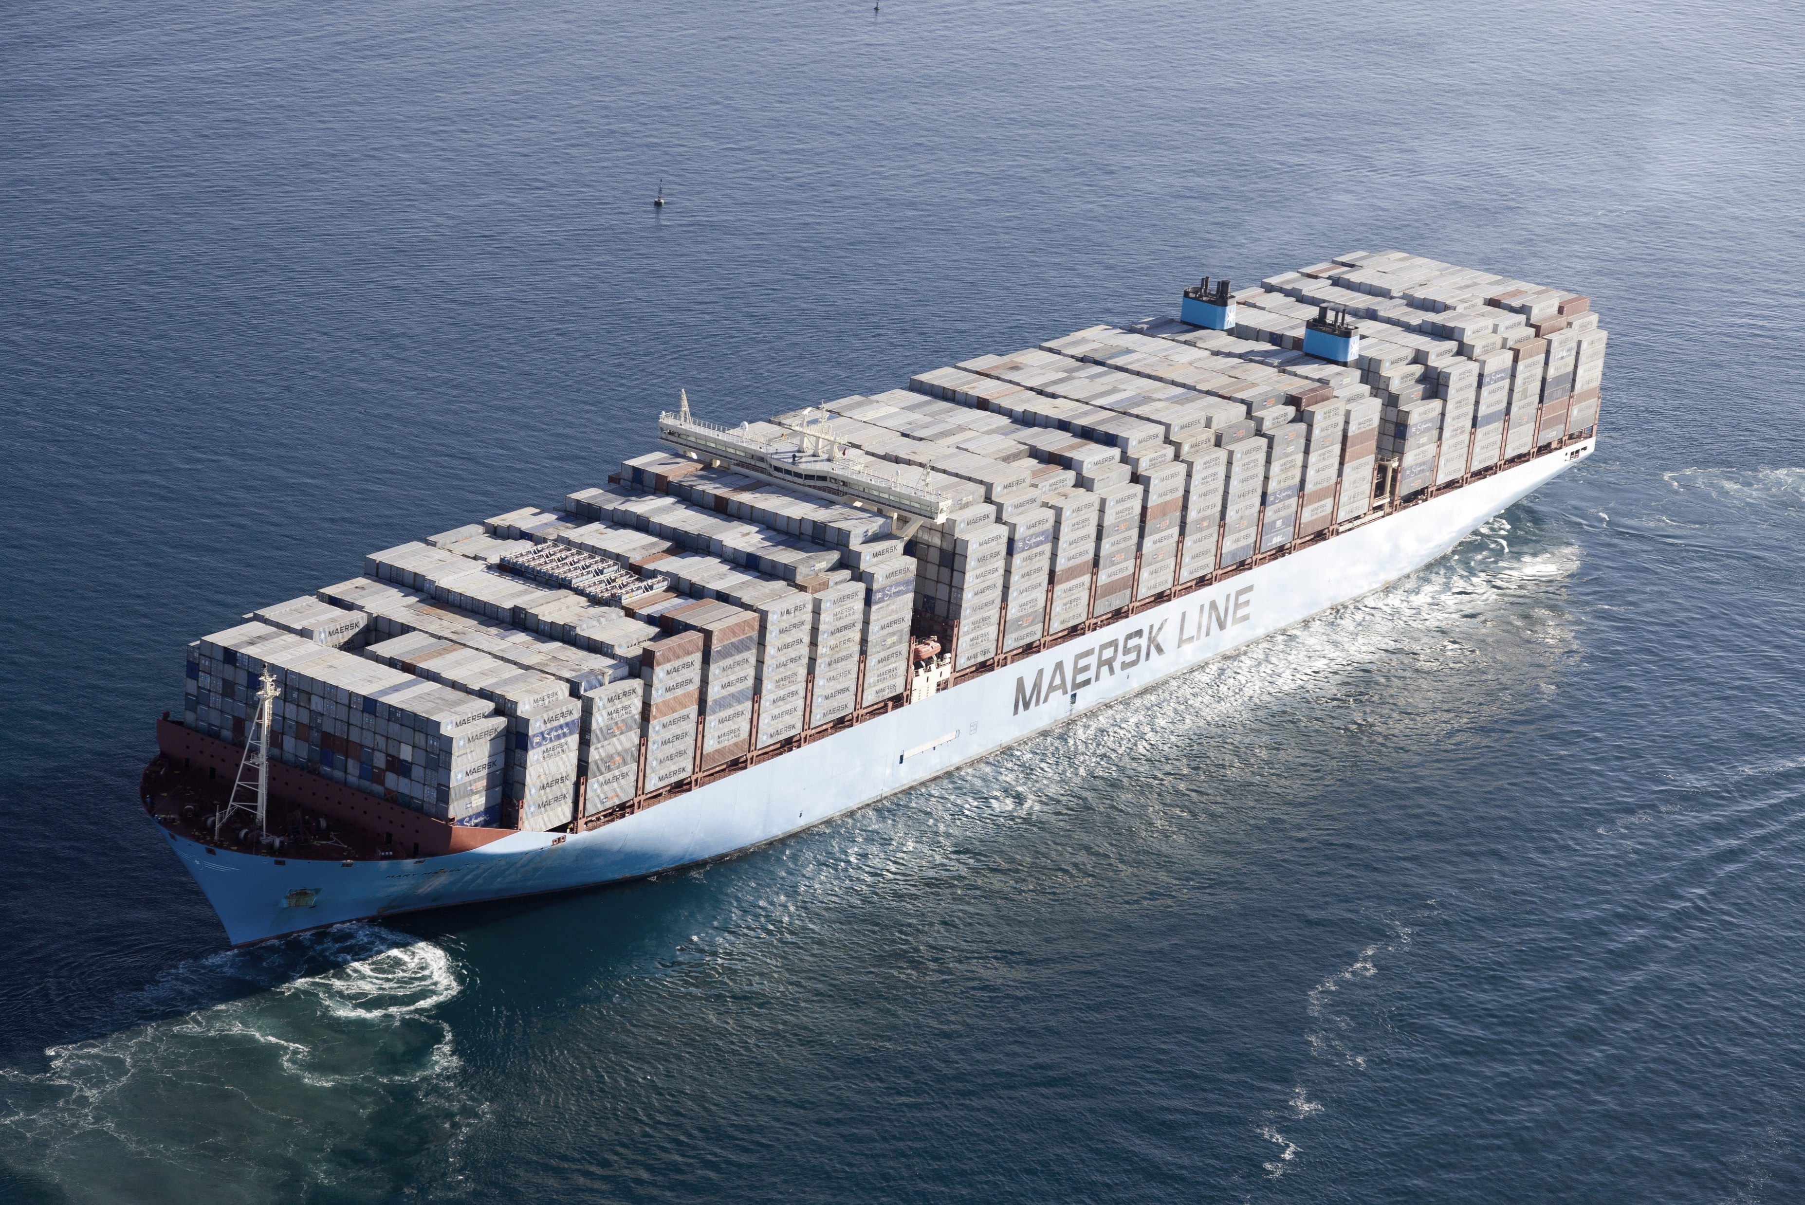
ACS
The Azure Container Service

Slide 39
The key players in ACS

Slide 40
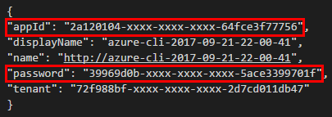
ACS/Kubernetes Prequisite (service principal)
az ad sp create-for-rbac --role="Contributor" --scopes="/subscriptions/{subscriptionID}"
results in …
Notes:
Before creating the ACS K8S. We need to create a service principal
The Service Principal needs to have a Contributor role in the scope of the entire subscription

Slide 41
ACS/Kubernetes Provisioning (azure-cli)
az group create --name {resource-group-name} --location {resource-group-location}
az acs create --service-principal {service-principal-appId} --client-secret {service-principal-password} --orchestrator-type kubernetes --resource-group {resource-group-name} --name {acs-name} --generate-ssh-keys --master-count {integer} --agent-count {integer}

Slide 42
Honorable Mention (acs-engine)
https://github.com/Azure/acs-engine
Notes:
An alternative method to provision ACS/K8S
Allows provisioning of K8S v 1.7
We’ve used it during #OpenHack

Slide 43
What’s inside

Slide 44
Let’s examine the ACS/K8S
DEMO
Notes:
In this demo:
We will see the provisioned ACS/K8S cluster
We will discuss scaling pitfalls in ACS
We will mention an acs-autoscaler that seeks to remedy the limitations of a VM Availability set in Azure

Slide 45


Kubernetes
Notes:
Kubernetes is the leading container orchestrator
trends.gogle.com

Slide 46
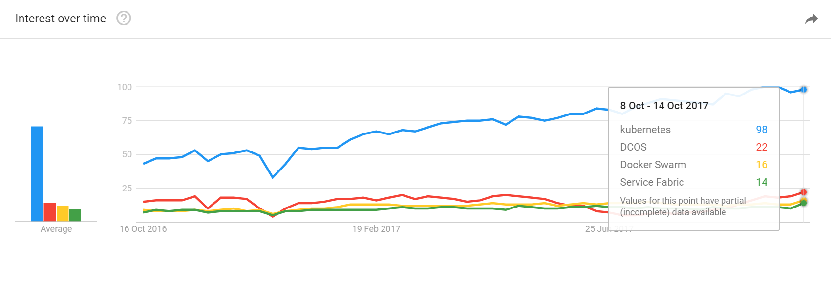
Kubernetes – Why?
Notes:
Most popular container orchestrator
Easy to learn
Easy to use

Slide 47
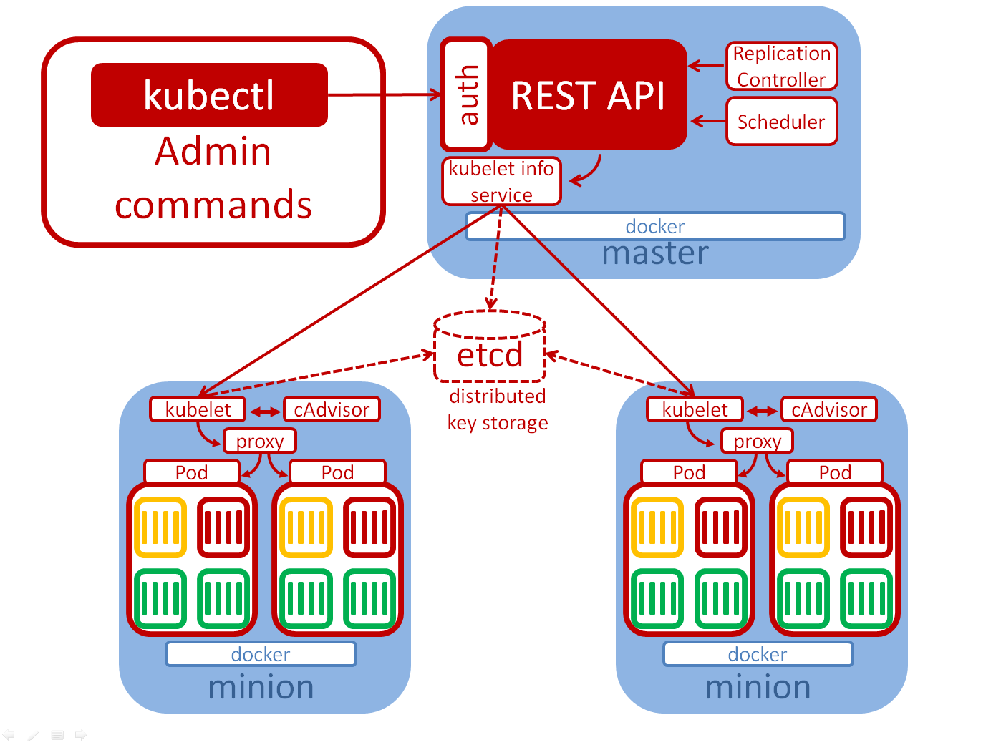
Kubernetes - Architecture

Slide 48
Kubernetes – Connecting to the Cluster
az acs kubernetes get-credentials --resource-group= {resource-group-name} --name= {acs-name}
SET KUBECONFIG=%UserProfile%/.kube/{context-config-file}
kubectl proxy –port 8080
Notes:
The config file contains the required certificates to connect to the cluster. If you want to share access, share the context configfile

Slide 49
Kubernetes - Secrets
{acr-name}.azurecr.io
kubectl create secret docker-registry {k8s-secret-name}
--docker-server={acr-name}.azurecr.io
--docker-username={acr-admin-username}
--docker-password={acr-admin-password}
--docker-email={email}

Slide 50
Kubernetes - Pods
app=demo-app-web
version=123
Notes:
Contains heterogeneous container images
Mixing stateless nad stateful is not a good idea due to scalability issues
One container is considered to be the main container, while other are called „sidecars”
Containers within one pod communicate over the localhost i-face

Slide 51
Kubernetes - Deployments
apiVersion: apps/v1beta1 # k7s 1.7+
kind: Deployment
metadata:
name: nginx-deployment
spec:
replicas: 10
strategy:
type: RollingUpdate
rollingUpdate:
maxUnavailable: 2
maxSurge: 2
template:
metadata:
labels:
app: nginx
spec:
containers:
- name: nginx
image: nginx:1.7.9
ports:
- containerPort: 80
Replica Set
Notes:
The YAML definition of the deployment has a REST API reprenestation
They handle rolling updates & rollbacks
They specify how many replicas of a pod are running (manual scaling)

Slide 52
Kubernetes - Services
Service
app=demo-app-web
Reliable IP
Reliable Port
Reliable DNS
version=123
Label Selector
Notes:
Services expose pods to other pods or to external clients
Creation of a service, creates an endpoint
Createion of a service, creates a DNS record, resolveable within the cluster
Internal Services =
NodePort =
LoadBalancer Service Type = Extends the NodePort, K8S will have the Cloud Provider create a Load Balancer

Slide 53
So.. What are we going to do next?
VSTS
ACR
Kubernetes
configMap.yml
deployment.yml
service.yml
job.yml
Notes:
AppService (win/nix)
ASF (win/nix)
ACS (nix/win on k8s preview)
ACI

Slide 54
VSTS to Kubernetes Deployment
DEMO
Notes:
Manual Deployment Demo

Slide 55


Closing words
https://github.com/mmisztal1980/NetDeveloperDays2017
Notes:
We have seen how to package the project using VSTS
We have seen how to push the image to an ACR instance
We have seen how to deploy an actual project to ACS running Kubernetes

Slide 56
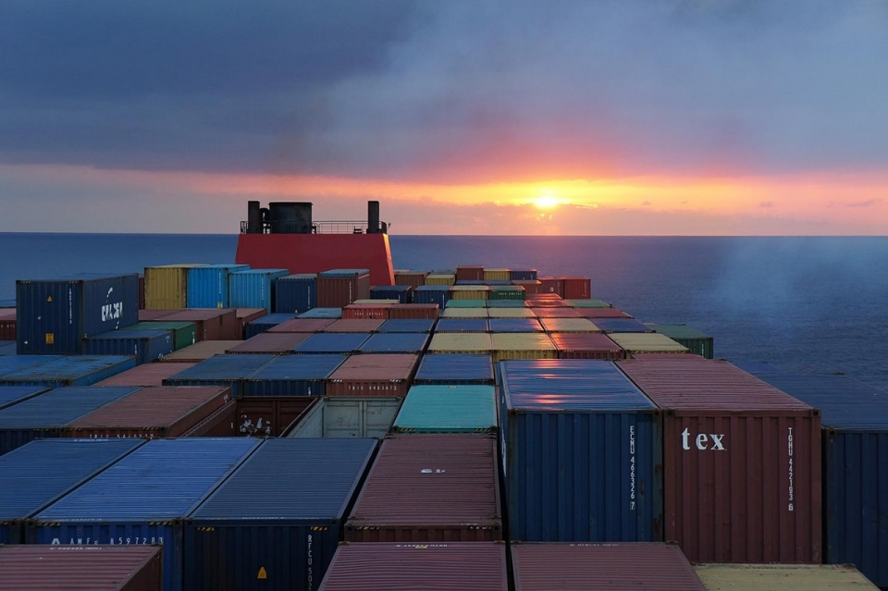
The End

